Slide 1







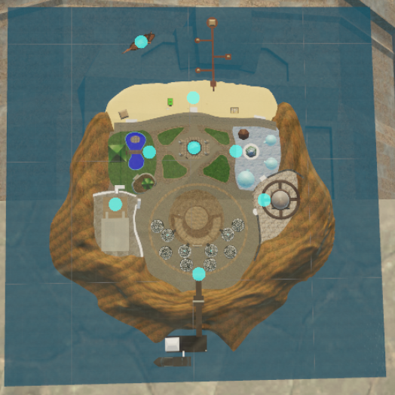
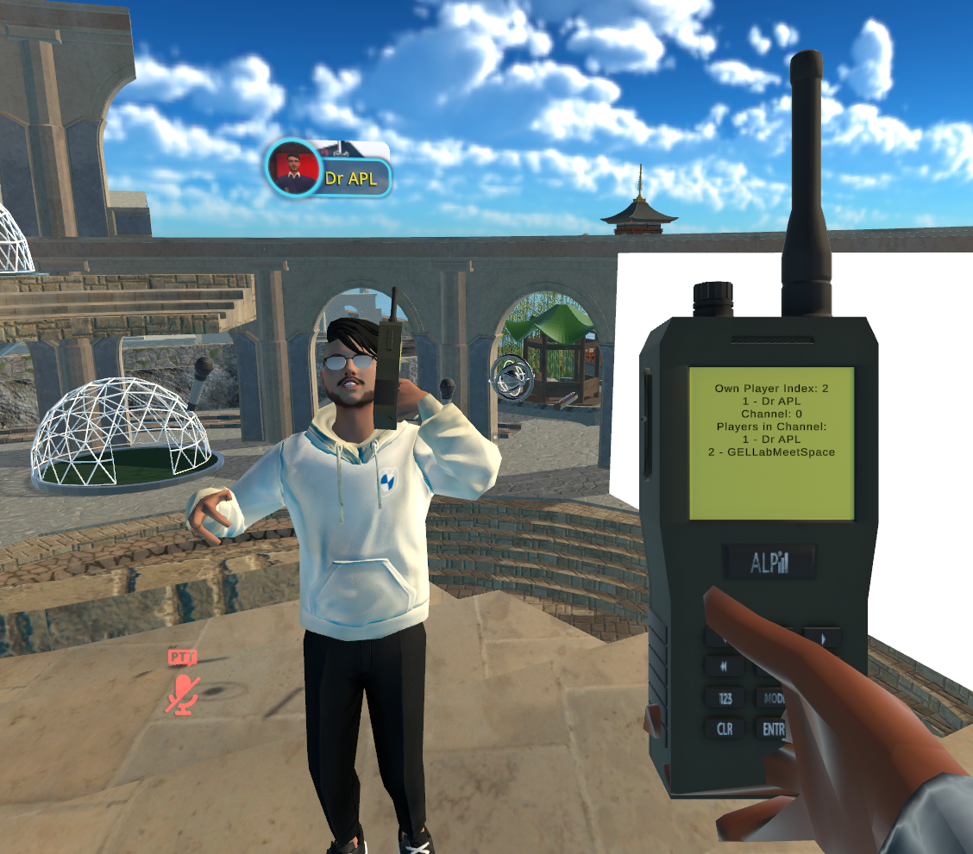

2128803: Virtual Meeting Support for Enhanced Well-Being and Equity for Game Developers (2023)
Leadership Team: Rabindra (Robby) Ratan, Michigan State U, rar@msu.edu; Maxwell Foxman, U of Oregon; Alex Leith, SIU Edwardsville; Brian Winn, Michigan State U; David Beyea, U of Wisconsin-Whitewater; Brian Klebig, Bethany Lutheran College
study overview
activity progress
key findings from products (2023) and studies in-progress
Natural language processing to identify virtual meeting terminology
Twitter post data (5,073,146 tweets) collected, analyses in progress
Top three expressed emotions related to VR on twitter: anticipation, joy, and trust.
  Users felt mostly positive about VR, with hope and anticipation for future use.
Emotional responses to VR are tied to both future anticipation and physical limitations
  e.g., cybersickness, income
Interviewees suggest VR is not only for play & gaming, despite longstanding ties.
Remote work is efficient, but social isolation is common among developers.
Developers did not want “serious” meetings in VR.
  Instead, they want informal and unstructured social play (e.g., toys, puzzles)
Fidgeting is good! Focusing on fun collective activities was most successful.
Developers see play as instrumental in production,
  Especially true for testing tools & creating examples.
Time spent in VR meetings has a curvilinear relationship with enjoyment.
Onboarding—learning to use HMDs, accounts and avatars—is essential.
  Onboarding issues are prevalent, significant barriers to VR platform adoption.
Virtual meeting platform features (e.g., self-presentation mods) are correlated with virtual meeting fatigue and other psychological outcomes (e.g., social interaction anxiety, perceived competence, relatedness, autonomy).
  Effects vary by demographics (e.g., gender, race, and years of job experience).
STUDY 1
Large survey to explore virtual meeting features' statistical association
Data fully collected from 2400+ survey participants, analyses in progress
STUDY 2
Worker interviews to contextualize Studies 1 & 2
30 interviews conducted,
analyses in progress
STUDY 3
Video virtual meeting experiment to test hypotheses derived from Studies 1-3
Experiment design in progress based on Studies 1-3 & Study 5 prototype
STUDY 4
Prototype virtual reality meeting platform to embody and validate Studies 1-4 insights
Platform alpha prototyped in VR Chat, 10+ communication features developed
STUDY 5
Special issue on human communication in the realms of work, education, and socialization: CFP tentatively approved by J Media Psych
meetspace platform Alpha prototype
Products (2023)
Virtual limited: Boundaries of play in virtual reality production. DiGRA 2023
Mixed feelings and realities: Joyful to nauseating sentiments about VR on Twitter. DiGRA 2023
Playfully Virtual: Finding Authentic Communication in Videoconferencing and Online Meetings. International Communication Association, 2023
Diffusion of gratification: The reception of VR as a modality for remote work and meetings. International Communication Association 2023
Feelings for meetings: A sentiment analysis of videoconferencing platforms a year apart. International Communication Association 2023
Meaningful XR
Conference CFP in development
www.
beyondmeet.
space
Support
for 8 graduate students (Chaeyun Lim, Dayeoun Jang, Alex Lover, Qiyang Lin, Dalton Bouzek, Luis Graciano, Hanjie Liu, Mary Onuche) & 7 undergraduates

Slide 2
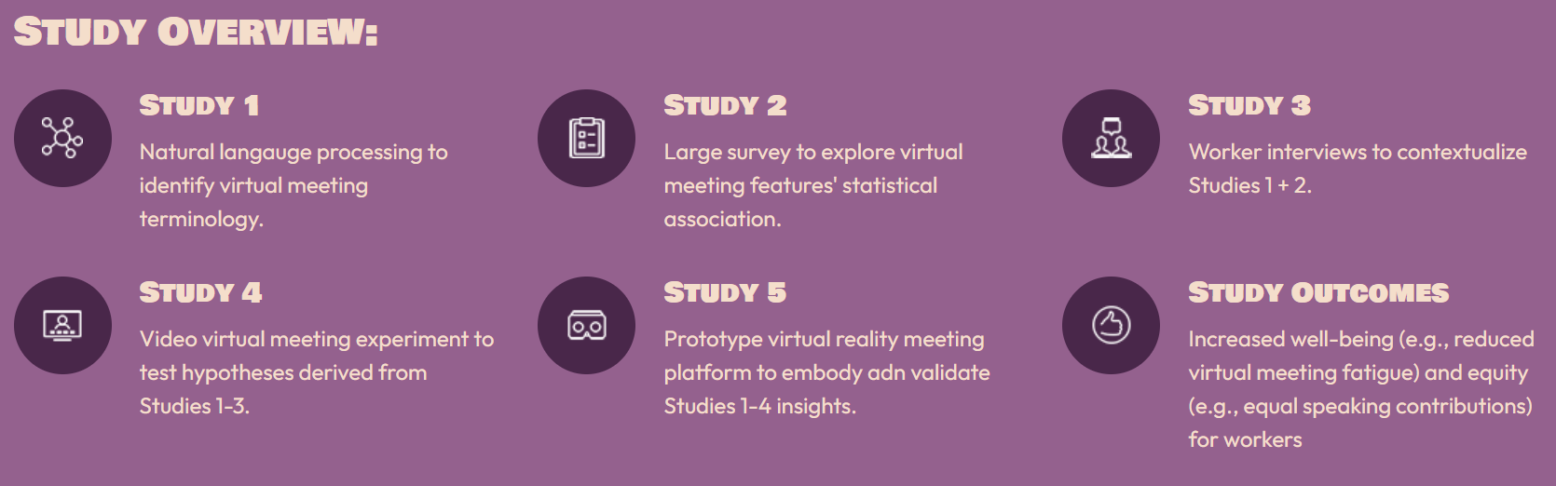
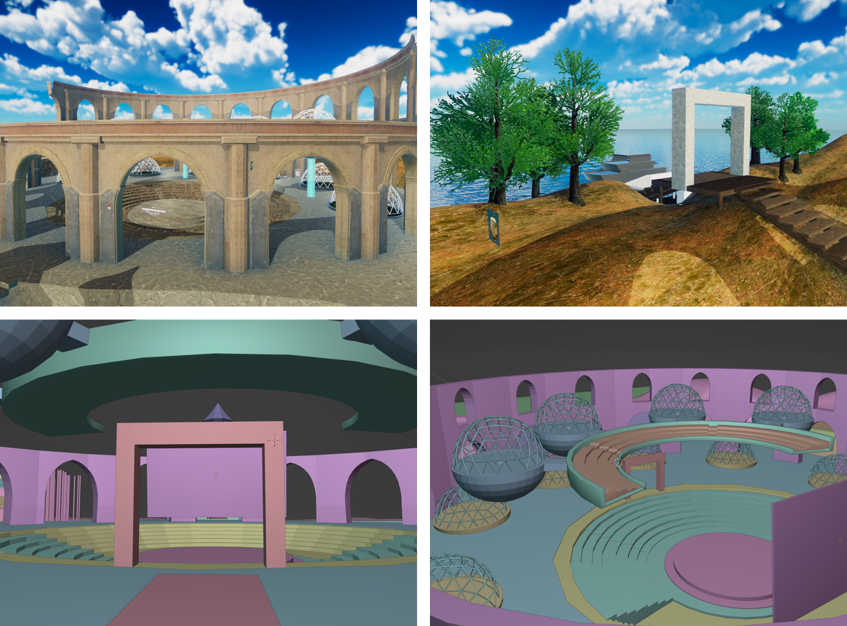
2128803: Virtual Meeting Support for Enhanced Well-Being and Equity for Game Developers (2023)
Rabindra (Robby) Ratan, Michigan State U, rar@msu.edu; Maxwell Foxman, U of Oregon; Alex Leith, SIU Edwardsville; Brian Winn, Michigan State U; David Beyea, U of Wisconsin; Brian Klebig, Bethany Lutheran College
Activity Progress
Study 1: Twitter Post Data (5,073,146 tweets) fully collected, analyses in progress Study 2: Data fully collected from 2400+ Survey Participants, analyses in progress Study 3: 30 Interviews Conducted, analyses in progress Study 4: Experiment design in progress Study 5: Platform fully prototyped in VR Chat, 10+ communication features developed Website: beyondmeet.space continually updated Special Issue on human communication in the realms of work, education, and socialization: CFP tentatively approved by J Media Psych Meaningful XR Conference: CFP being in development Students support for 6 PhD, 2 MA, and 7 undergrad
Products
Virtual limited: Boundaries of play in virtual reality production. DiGRA 2023 Mixed feelings and realities: Joyful to nauseating sentiments about VR on Twitter. DiGRA 2023 Playfully Virtual: Finding Authentic Communication in Videoconferencing and Online Meetings. ICA 2023 Diffusion of gratification: The reception of VR as a modality for remote work and meetings. ICA 2023 Feelings for meetings: A sentiment analysis of videoconferencing platforms a year apart. ICA 2023
Key Findings from Products and Works In-Progress
The top three expressed emotions related to VR on twitter were anticipation, joy, and trust, suggesting that users mostly felt positive about VR, with strong hope and anticipation for its future use. The emotional responses to VR are tied to both immediate and future anticipation surrounding VR, as well as physical limitations, such as cybersickness and other physical limitations present in the technology. These limitations, along with income, were also expressed in interviews. Interviewees suggest VR is not being developed exclusively for play and gaming, but paradoxically is seen as tied to gaming contexts Fidgeting is good! Finding fun ways to focus on collective activities had some success. Developers perceive play as detached from the conception of VR content, it is instrumental in the actual production process, particularly in terms of development tools and popular examples Developers did not want “serious” meetings to happen in VR, but instead informal and unstructured social play that does not resemble traditional gaming (e.g., toys, puzzles, social gatherings). Time spent in VR meetings has a curvilinear relationship with enjoyment Interviewees find onboarding—the lengthy process of both using HMDs and creating affiliated accounts and aviators—both colleagues, employees and clients presents significant barriers to consistent adoption Social isolation is common amongst developers while efficiency remains high and even benefits from remote work Relationships found between virtual meeting fatigue, virtual meeting feature use, social interaction anxiety, perceived competence, relatedness, video meeting time, gender, race, years of job experience, and age
Prototype Virtual Meeting Platform (pls add overview top-down map)
Notes:
Give instructions here…

Slide 3
2128803: Virtual Meeting Support for Enhanced Well-Being and Equity for Game Developers (2023)
Rabindra (Robby) Ratan, Michigan State U, rar@msu.edu; Maxwell Foxman, U of Oregon; Alex Leith, SIU Edwardsville; Brian Winn, Michigan State U; David Beyea, U of Wisconsin; Brian Klebig, Bethany Lutheran College
Key Findings from Products and Works In-Progress
The top three expressed emotions related to VR on twitter were anticipation, joy, and trust, suggesting that users mostly felt positive about VR, with strong hope and anticipation for its future use. The emotional responses to VR are tied to both immediate and future anticipation surrounding VR, as well as physical limitations, such as cybersickness and other physical limitations present in the technology. These limitations, along with income, were also expressed in interviews. Interviewees suggest VR is not being developed exclusively for play and gaming, but paradoxically is seen as tied to gaming contexts Fidgeting is good! Finding fun ways to focus on collective activities had some success. Developers perceive play as detached from the conception of VR content, it is instrumental in the actual production process, particularly in terms of development tools and popular examples Developers did not want “serious” meetings to happen in VR, but instead informal and unstructured social play that does not resemble traditional gaming (e.g., toys, puzzles, social gatherings). Time spent in VR meetings has a curvilinear relationship with enjoyment Interviewees find onboarding—the lengthy process of both using HMDs and creating affiliated accounts and aviators—both colleagues, employees and clients presents significant barriers to consistent adoption Social isolation is common amongst developers while efficiency remains high and even benefits from remote work Relationships found between virtual meeting fatigue, virtual meeting feature use, social interaction anxiety, perceived competence, relatedness, video meeting time, gender, race, years of job experience, and age
Products (2023)
Virtual limited: Boundaries of play in virtual reality production. DiGRA 2023 Mixed feelings and realities: Joyful to nauseating sentiments about VR on Twitter. DiGRA 2023 Playfully Virtual: Finding Authentic Communication in Videoconferencing and Online Meetings. ICA 2023 Diffusion of gratification: The reception of VR as a modality for remote work and meetings. ICA 2023 Feelings for meetings: A sentiment analysis of videoconferencing platforms a year apart. ICA 2023
Activity Progress
Study 1: Twitter Post Data (5,073,146 tweets) fully collected, analyses in progress Study 2: Data fully collected from 2400+ Survey Participants, analyses in progress Study 3: 30 Interviews Conducted, analyses in progress Study 4: Experiment design in progress Study 5: Platform fully prototyped in VR Chat, 10+ communication features developed Website: beyondmeet.space continually updated Special Issue on human communication in the realms of work, education, and socialization: CFP tentatively approved by J Media Psych Meaningful XR Conference: CFP being in development Students support for 6 PhD, 2 MA, and 7 undergrad
Meetspace Platform Protype
Notes:
Give instructions here…

Slide 4
2128803: Virtual Meeting Support for Enhanced Well-Being and Equity for Game Developers
Rabindra (Robby) Ratan, Michigan State U, rar@msu.edu; Maxwell Foxman, U of Oregon; Alex Leith, SIU Edwardsville; Brian Winn, Michigan State U; David Beyea, U of Wisconsin; Brian Klebig, Bethany Lutheran College
Proceedings |  | Presentations
Virtual limited: Boundaries of play in virtual reality production. DiGRA 2023 | Mixed feelings and realities: Joyful to nauseating sentiments about VR on Twitter. DiGRA 2023 | Playfully Virtual: Finding Authentic Communication in Videoconferencing and Online Meetings. ICA 2023 | Diffusion of gratification: The reception of VR as a modality for remote work and meetings. ICA 2023 | Feelings for meetings: A sentiment analysis of videoconferencing platforms a year apart. ICA 2023
Works in Progress
Exploring virtual meeting feature use behaviors of workers: How to support workplace wellbeing through virtual meeting technologies A meta-analysis of the Zoom Exhaustion and Fatigue Scale Virtual reality in motion: Mixed-method analysis of VR use for remote work Dreaming a virtual reality: VRChat as a means of escaping crises Lost in virtual reality: VRChat as a model for continued VR use Should I adopt meeting platforms that make me fatigued?: Exploring the role of Zoom fatigue in predicting intention to use a meeting platform in the workplace setting using TAM framework. Why should nonverbal communication be supported in virtual meetings?: Examining the role of nonverbal immediacy and social interaction anxiety in predicting Zoom fatigue. The HMDs the Thing: The Process of Onboarding as Barriers for Social VR Playfully Virtual: Barriers and Opportunities to Play in Virtual Meetings Potential versus Reality: Early Adopter Resistance to VR Meetings Special Issue with the Journal of Media Psychology
Notes:
Give instructions here…

